Slide 1
Unit II - REGRESSION ANALYSIS AND FORECASTING

Slide 2
Unit outcome
2. Illustrate the regression analysis and forecasting in time series analysis

Slide 3
What is regression?
Regression Analysis is a supervised learning analysis where supervised learning is the analyzing or predicting the data based on the previously available data or past data.
Regression analysis is a statistical technique for modeling and investigating the relationships between an outcome or response variable and one or more predictor or regressor variables.

Slide 4
Purpose of regression analysis:
The end result of a regression analysis study is often to generate a model that can be used to forecast or predict future values of the response variable, given specified values of the predictor variables.

Slide 5
Types of regression analysis
Simple Linear Regression:
In this simple linear regression there is only one dependent and one independent variable.
This linear regression model only one predictor. This linear regression model gives the linear relationship between the dependent and independent variables.
This simple linear regression analysis is mostly used in weather forecasting, financial analysis , market analysis .
It can be used for the predicting outcomes , increasing the efficiency of the models , make necessary measures to prevent the mistakes of the model.
Notes:
https://www.geeksforgeeks.org/what-is-regression-analysis/

Slide 6

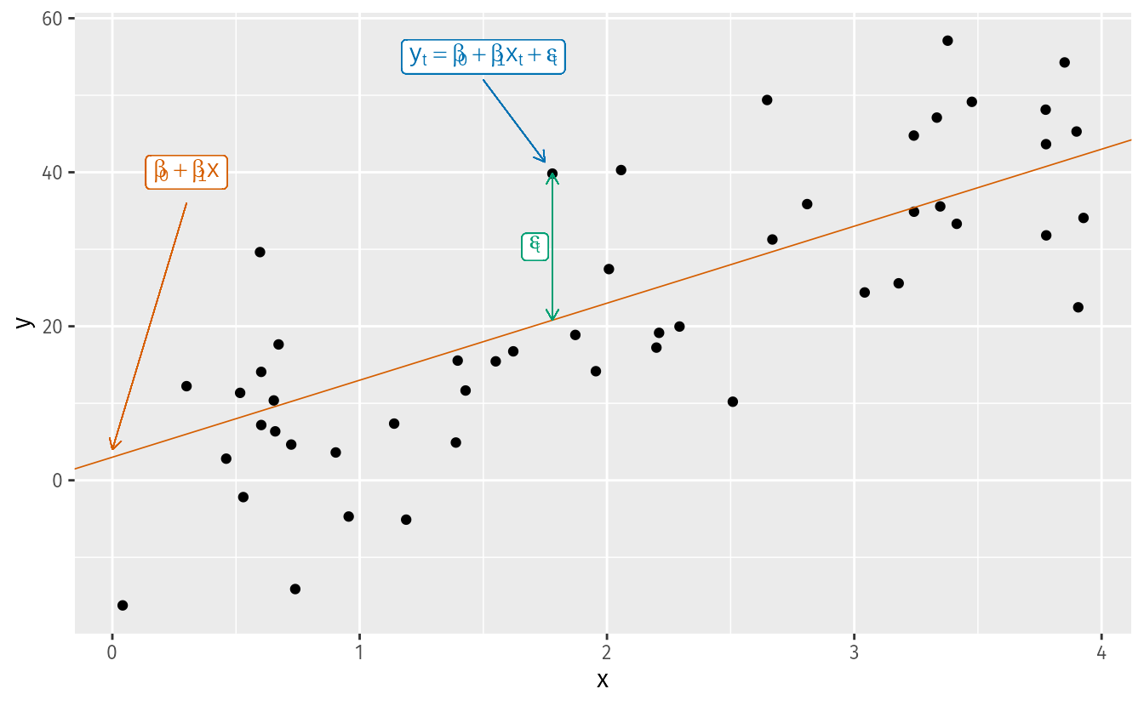
the regression model allows for a linear relationship between the forecast variable y and a single predictor variable x
The coefficients β0 and β1 denote the intercept and the slope of the line respectively.
The intercept β0 represents the predicted value of y when x=0.
The slope β1 represents the average predicted change in y resulting from a one unit increase in x.

Slide 7
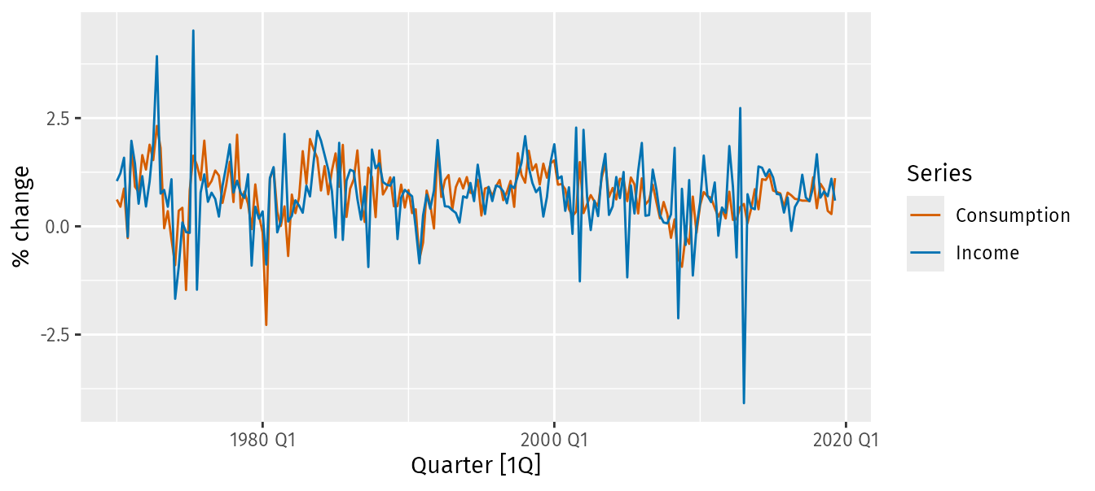
Example: US consumption expenditure
Figure shows time series of quarterly percentage changes (growth rates) of real personal consumption expenditure, y, and real personal disposable income, x, for the US from 1970 Q1 to 2019 Q2.
us_change |>
pivot_longer(c(Consumption, Income), names_to="Series") |>
autoplot(value) +
labs(y = "% change")

Slide 8

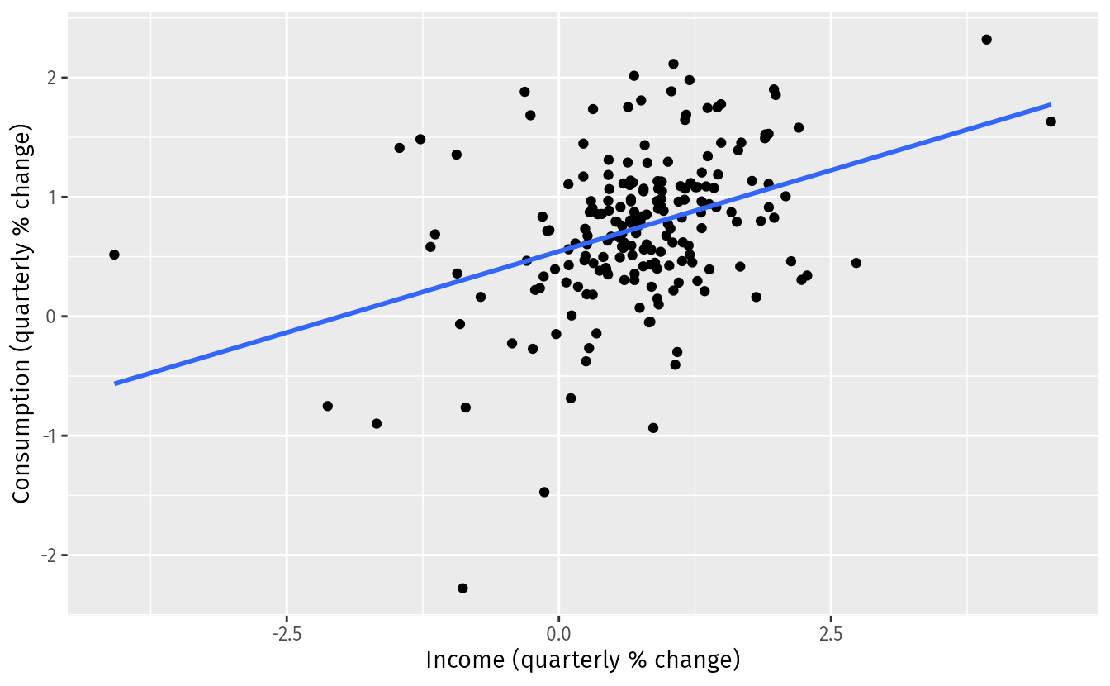
A scatter plot of consumption changes against income changes is shown in Figure along with the estimated regression line
us_change |>
ggplot(aes(x = Income, y = Consumption)) +
labs(y = "Consumption (quarterly % change)",
x = "Income (quarterly % change)") +
geom_point() +
geom_smooth(method = "lm", se = FALSE)

Slide 9
The mathematical equation for the simple linear regression model is shown below.
y=ax+b
where y is a dependent variable
x is a independent variable
a, b are the regression coefficients

Slide 10
Let us now calculate the value of a and b by solving the normal equations of the linear regression curve.
Normal equations of the linear regression equation y= b+ax is.
∑ y = n*b + a ∑ x
∑ x*y = b ∑ x + a ∑ x^2
where n is the total number of observations of the provided data/information for the above given information n=10
x | y | x^2 | xy
8 | 11 | 64 | 88
5 | 10 | 25 | 50
4 | 4 | 16 | 16
6 | 8 | 36 | 48
7 | 9 | 49 | 63
9 | 13 | 81 | 117
10 | 15 | 100 | 150
3 | 6 | 9 | 18
2 | 12 | 4 | 24
12 | 7 | 144 | 84

Slide 11
From the above table
n=10 , ∑ x = 66 , ∑ y = 95 , ∑ xy =1186 , ∑ x^2 = 528
Now the normal equations become :
95 = 10*b + 66a
1186 = 66*b + 528a
By solving the above two euations we get a = 6.05 and b = -30.429
The linear regression equation is y = -30.429 + 6.05 x.
Let us now discuss the implementation of the linear regression curve in R

Slide 12
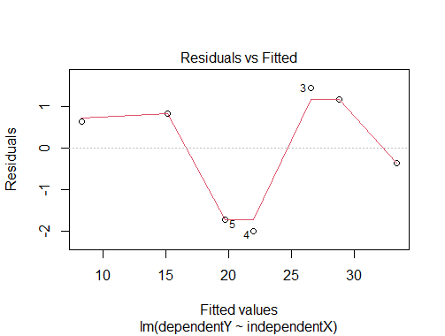
R Code
#Storing the independent value X
independentX<-c(5,7,8,10,11,13,16)
#soring the dependent value
dependentY<-c(33,30,28,20,18,16,9)
#performing the regression analysis using the function lm
linearregression<-lm(dependentY,independentX)
#printing the summary of the result
summary(linearregression)
#ploting the model
plot(linearregression)
plot(independentX,dependentY)

Slide 13

Multiple Linear Regression
Multiple linear regression analysis gives the relationship between the two or more independent varibales and a dependent variable.
Multiple linear regression can be represented as the hyper plane in multidimensional space . It is also a linear type regression analysis .
When there are two or more predictor variables, the model is called a multiple regression model. The general form of a multiple regression model is
where y is the variable to be forecast and x1,…,xk are the k predictor variables.
Each of the predictor variables must be numerical.
The coefficients β1,…,βk measure the effect of each predictor after taking into account the effects of all the other predictors in the model.
Thus, the coefficients measure the marginal effects of the predictor variables.

Slide 14
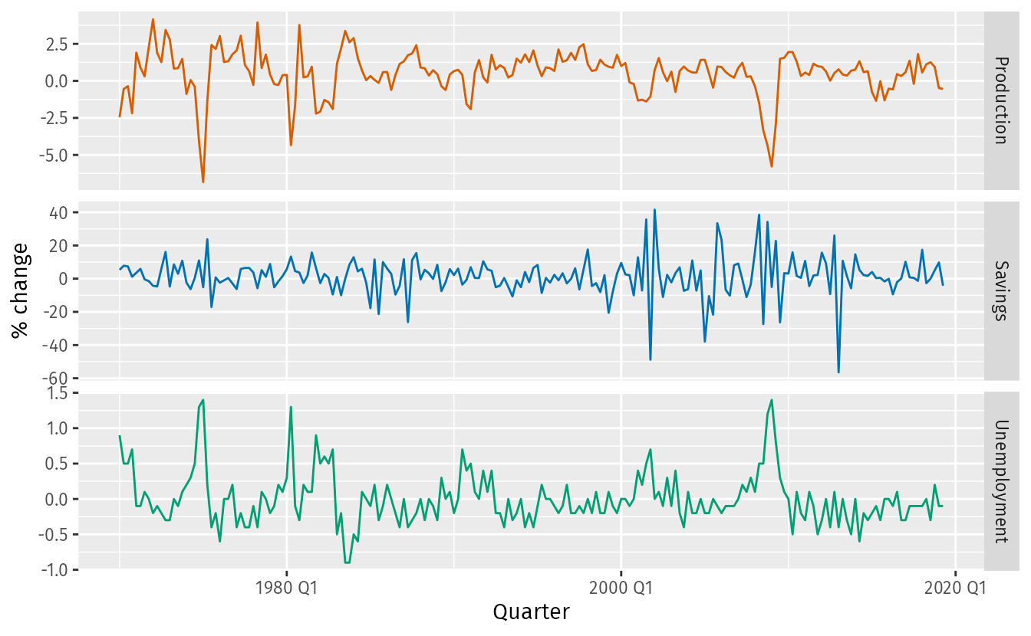
us_change |>
select(-Consumption, -Income) |>
pivot_longer(-Quarter) |>
ggplot(aes(Quarter, value, colour = name)) +
geom_line() +
facet_grid(name ~ ., scales = "free_y") +
guides(colour = "none") + labs(y="% change")

Slide 15
x1 | 1 | 2 | 3 | 4 | 5
x2 | 8 | 6 | 4 | 2 | 10
y | 3 | 7 | 5 | 9 | 11
x1 | x2 | y | x1^2 | x2^2 | x1*x2 | x1*y | x2*y
1 | 8 | 3 | 1 | 64 | 8 | 3 | 24
2 | 6 | 7 | 4 | 36 | 12 | 14 | 42
3 | 4 | 5 | 9 | 16 | 12 | 15 | 20
4 | 2 | 9 | 16 | 4 | 8 | 36 | 18
5 | 10 | 11 | 25 | 100 | 50 | 55 | 110
From the above table
n=5 , ∑ x1 = 15 , ∑ x2 = 30 , ∑ y = 35 , ∑ x1^2 = 55 , ∑ x2^2 = 220 , ∑ x1*x2 = 90 , ∑ x1*y = 123 , ∑ x2 *y = 214
Then the normal equations become: 35 = 5b + 15a0 + 30a1
123 = 15b + 55a0 + 90a1
214 = 30b + 90a0 + 220a1
By solving the above three normal equations we get the values of a0 , a1 and b .
a0 = 1.8 , a1 = 0.1 , b = 1.666
The multilinear regression analysis curve can be fit as y = 1.666 + 1.8*x1 + 0.1 * x2 .

Slide 16
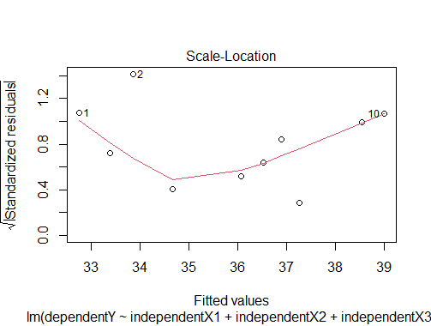
R Code
#in this we are performing the multi linear regression using the three independent
#storing the three independent variables
independentX1<-c(8,10,15,19,20,11,16,13,6,18)
independentX2<-c(22,26,24,32,38,39,29,13,15,25)
independentX3<-c(28,26,24,22,29,25,27,23,20,21)
#storing the dependent variable y
dependentY<-c(43,12,45,48,33,37,39,38,36,28)
#performing the multilinear regression analysis
multilinear<-lm(dependentY~independentX1+independentX2+independentX3)
#printing the summary of the result
summary(multilinear)
plot(multilinear)
Notes:
https://www.geeksforgeeks.org/what-is-regression-analysis/

Slide 17
Polynomial Regression
Polynomial regression analysis is a non linear regression analysis .
Polynomial regression analysis helps for the flexible curve fitting of the data , involves the fitting of polynomial equation of the data.
Polynomial regression analysis is the extension of the simple linear regression analysis by adding the extra independent variables obtained by raising the power .
y=a0+a1x+a2x^2+………..+anx^n
where y is dependent variable
x is independent variable
a0,a1,a2 are the coefficeients of independent variable.

Slide 18
Exponential Regression
Expenential regression is a non linear type of regression .
Exponential regression can be expressed in two ways .
Exponential regression can be used in finance , biology , physics etc fields . Let us look the mathematical expression for the exponential regression with example.
y=ae^(bx)
where y is dependent variable
x is independent variable
a , b are the regression coefficients.

Slide 19
What is the Least Squares Regression method and why use it?
Least squares is a method to apply linear regression.
It helps us predict results based on an existing set of data as well as clear anomalies in our data.
Anomalies are values that are too good, or bad, to be true or that represent rare cases.
we have a collection of observations but we do not know the values of the coefficients β0,β1,…,βk. These need to be estimated from the data.
The least squares principle provides a way of choosing the coefficients effectively by minimizing the sum of the squared errors.
That is, we choose the values of β0,β1,…,βk that minimize
Notes:
https://otexts.com/fpp3/least-squares.html

Slide 20

This is called least squares estimation because it gives the least value for the sum of squared errors.
Finding the best estimates of the coefficients is often called “fitting” the model to the data, or sometimes “learning” or “training” the model.

Slide 21
Example: US consumption expenditure
A multiple linear regression model for US consumption is
where y is the percentage change in real personal consumption expenditure,
x1 is the percentage change in real personal disposable income,
x2 is the percentage change in industrial production,
x3 is the percentage change in personal savings and
x4 is the change in the unemployment rate.

Slide 22
The TSLM() function fits a linear regression model to time series data.
It is similar to the lm() function which is widely used for linear models, but TSLM() provides additional facilities for handling time series.

Slide 23
fit_consMR <- us_change |>
model(tslm = TSLM(Consumption ~ Income + Production +
Unemployment + Savings))
report(fit_consMR)
#> Series: Consumption
#> Model: TSLM
#>
#> Residuals:
#> Min 1Q Median 3Q Max
#> -0.9055 -0.1582 -0.0361 0.1362 1.1547
#>
#> Coefficients:
#> Estimate Std. Error t value Pr(>|t|)
#> (Intercept) 0.25311 0.03447 7.34 5.7e-12 ***
#> Income 0.74058 0.04012 18.46 < 2e-16 ***
#> Production 0.04717 0.02314 2.04 0.043 *
#> Unemployment -0.17469 0.09551 -1.83 0.069 .
#> Savings -0.05289 0.00292 -18.09 < 2e-16 ***
#> ---
#> Signif. codes: 0 '***' 0.001 '**' 0.01 '*' 0.05 '.' 0.1 ' ' 1
#>
#> Residual standard error: 0.31 on 193 degrees of freedom
#> Multiple R-squared: 0.768, Adjusted R-squared: 0.763
#> F-statistic: 160 on 4 and 193 DF, p-value: <2e-16

Slide 24

Fitted values
Predictions of y can be obtained by using the estimated coefficients in the regression equation and setting the error term to zero. In general we write,
Plugging in the values of x1,t,…,xk,t for t=1,…,T returns predictions of yt within the training set, referred to as fitted values.

Slide 25
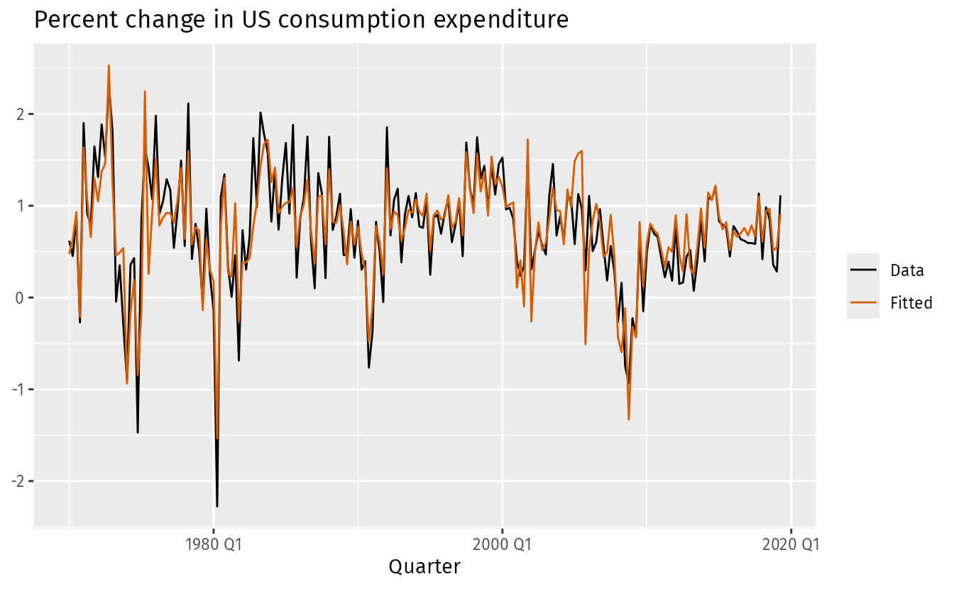
augment(fit_consMR) |>
ggplot(aes(x = Quarter)) +
geom_line(aes(y = Consumption, colour = "Data")) +
geom_line(aes(y = .fitted, colour = "Fitted")) +
labs(y = NULL,
title = "Percent change in US consumption expenditure"
) +
scale_colour_manual(values=c(Data="black",Fitted="#D55E00")) +
guides(colour = guide_legend(title = NULL))

Slide 26
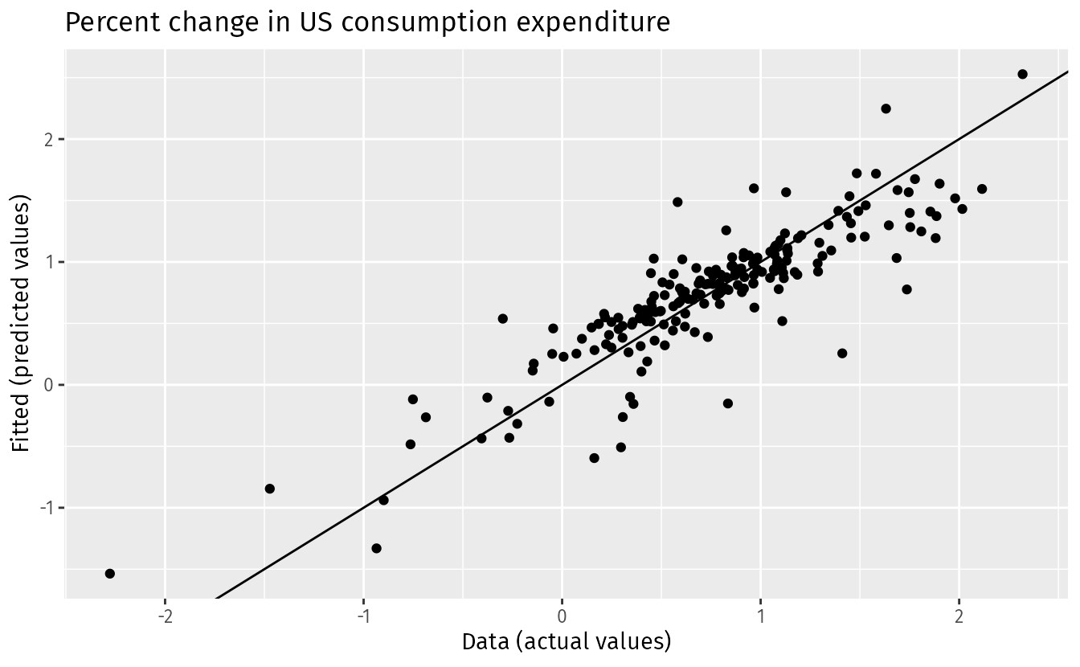
augment(fit_consMR) |>
ggplot(aes(x = Consumption, y = .fitted)) +
geom_point() +
labs(
y = "Fitted (predicted values)",
x = "Data (actual values)",
title = "Percent change in US consumption expenditure"
) +
geom_abline(intercept = 0, slope = 1)

Slide 27
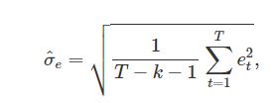
Standard error of the regression
Another measure of how well the model has fitted the data is the standard deviation of the residuals, which is often known as the “residual standard error”
The standard error will be used when generating prediction intervals,
where k is the number of predictors in the model.
Notice that we divide by T−k−1 because we have estimated k+1 parameters (the intercept and a coefficient for each predictor variable) in computing the residuals.
The standard error is related to the size of the average error that the model produces.

